Slide 1

Department of ME
23ME1103
Formatting of HTML Element and
HTML Attributes
Session-2
A COMPLETE SOLUTION TO
DESIGN TOOLS WORKSHOP
K L U Students
1st year
For
EXIT

Slide 2



AIM OF THE SESSION
To familiarize students with the HTML elements and attributes
INSTRUCTIONAL OBJECTIVES
This Session is designed to: Obtain knowledge of HTML elements and attributes
LEARNING OUTCOMES
At the end of this session, you should be able to: Understand the HTML elements and attributes

Slide 3
SESSION INTRODUCTION
Programmable logic falls into two different types:
1. Understanding of HTML elements
2. Understanding of HTML attributes

Slide 4

HTML Document
An HTML document is a file containing Hypertext Mark-up Language, and its filename most often ends in the .html extension.
An HTML document is a text document read in by a Web browser and then rendered on the screen.
The <html> element is the root element and it defines the whole HTML document.
The <head> element is where we given meta data about the webpage. <title> and others
The <body> element defines the document's body.
The elements with no content are called empty elements.

Slide 5
Session Plan: 2
SESSION DESCRIPTION
Summary of Last Session- 5 min
Topic – Formatting of HTML Elements and Attributes of HTML-20 min
Split to sections- 5min
Experimentation using tool -40 min
Assessment and Interaction (Active Learning Method) – 10 min
Documenting Results Summary and result Explanation- 20 min
Submitting as Assignment in LMS

Slide 6
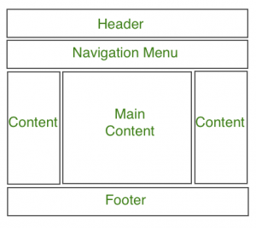
HTML Document Structure

Slide 7
Basic Basic HTML Elements
the heading <h1>-<h6> tags
the <p> tag
the <a> tag
the <img /> tag

Slide 8
HTML Elements Text Formatting
<b> - Bold text
<strong> - Important text
<i> - Italic text
<em> - Emphasized text
<mark> - Marked text
<small> - Smaller text
<del> - Deleted text
<ins> - Inserted text
<sub> - Subscript text
<sup> - Superscript text
<pre> preformatted Tag

Slide 9
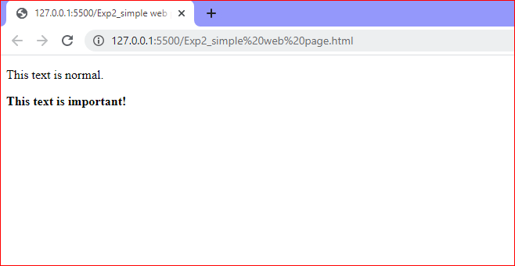
The HTML <strong> element defines text with strong importance. The content inside is typically displayed in bold.
<strong>This text is important!</strong>

Slide 10
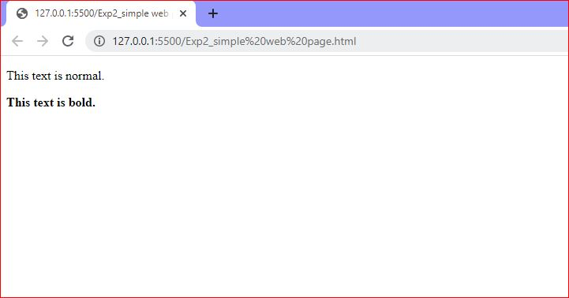
i) HTML <b> and <strong> Elements:
The HTML <b> element defines bold text, without any extra importance.
<b>This text is bold</b>

Slide 11
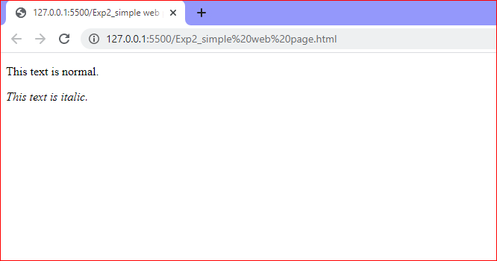
ii) HTML <i> and <em> Elements
The HTML <i> element defines a part of text in an alternate voice or mood.
The content inside is typically displayed in italic.
<i>This text is italic</i>

Slide 12
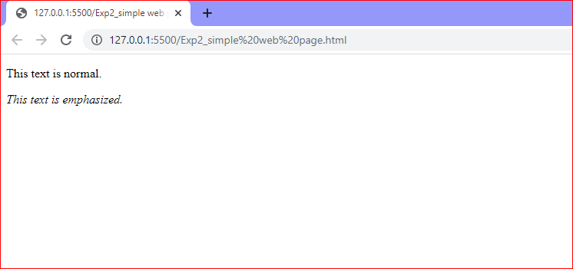
The HTML <em> element defines emphasized text. The content inside is typically displayed in italic.
<em>This text is emphasized</em>

Slide 13
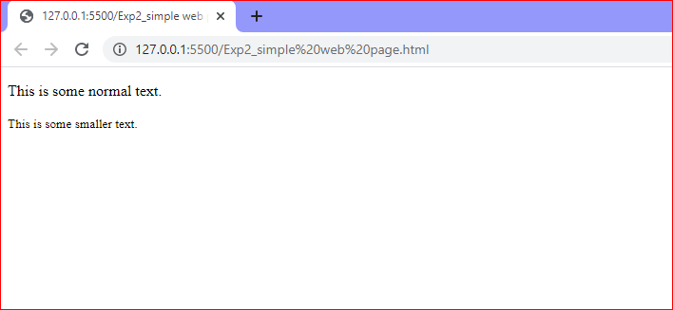
iii) HTML <small> Element
The HTML <small> element defines smaller text
<small>This is some smaller text.</small>

Slide 14
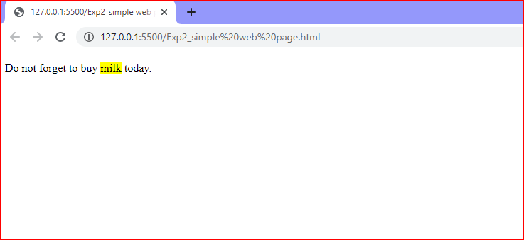
iv) HTML <mark> Element
The HTML <mark> element defines text that should be marked or highlighted:
<p>Do not forget to buy <mark>milk</mark> today.</p>

Slide 15
HTML Attributes
All HTML elements can have attributes
Attributes provide additional information about elements
Attributes are always specified in the start tag
Attributes usually come in name/value pairs like: name="value"

Slide 16
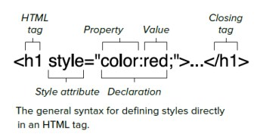
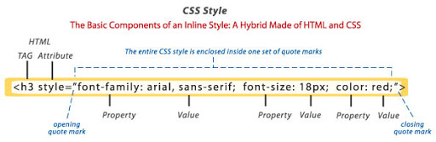
Style Attribute

Slide 17
Style Attribute (cont.)
<tagname style="property:value;">
Background Color
  <p style="background-color:powderblue;">…</p>
  Set background color for two different elements:
Text Color
  <h1 style="color:blue;">This is a heading</h1>
  <p style="color:red;">This is a paragraph.</p>
Fonts
  <h1 style="font-family:verdana;">This is a heading</h1>
  <p style="font-family:courier;">This is a paragraph.</p>

Slide 18
The Style Attribute (cont.)
Text Size
  <h1 style="font-size:300%;">This is a heading</h1>
  <p style="font-size:160%;">This is a paragraph.</p>
Text Alignment
  <h1 style="text-align:center;">Centered Heading</h1>
  <p style="text-align:center;">Centered paragraph.</p>

Slide 19
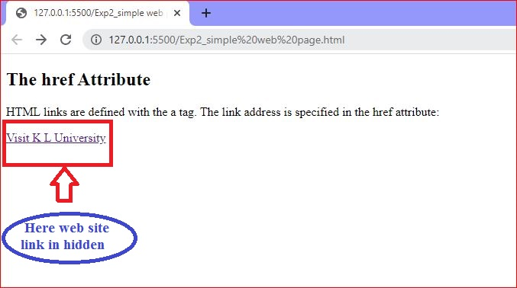
The href Attribute:
The <a> tag defines a hyperlink. The href attribute specifies the URL of the page the link goes to:
<a href="https://www.kluniversity.in/ "> Visit K L University web site </a>

Slide 20
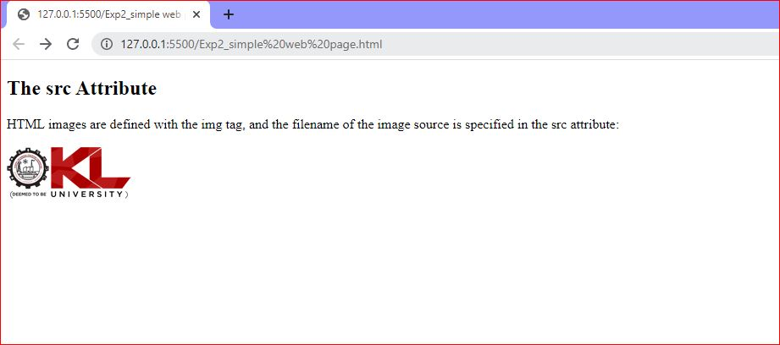
The src Attribute:
The <img> tag is used to embed an image in an HTML page. The src attribute specifies the path to the image to be displayed: <img src="KL_logo.jpg">

Slide 21
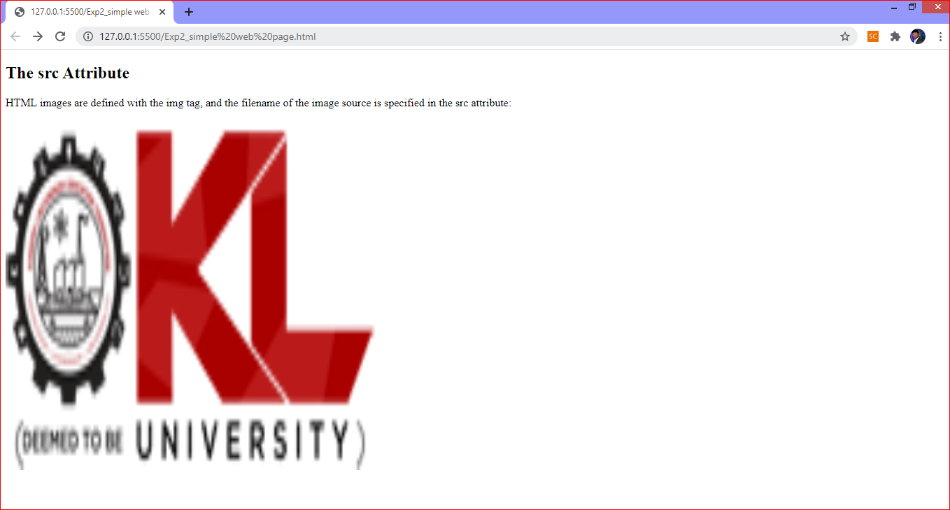
The width and height Attributes:
The <img> tag should also contain the width and height attributes, which specifies the width and height of the image (in pixels):
<img src="KL_logo.jpg" width="500" height="600">

Slide 22
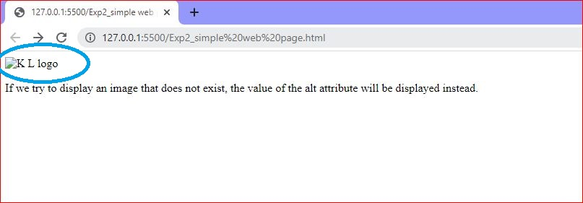
The alt Attribute:
The required alt attribute for the <img> tag specifies an alternate text for an image, if the image for some reason cannot be displayed. This can be due to slow connection, or an error in the src attribute, or if the user uses a screen reader.
<img src="KL_logo" alt="no image">

Slide 23


Slide 24
Assignment
Create a HTML Document with Text Formatting and Styles.
Create a hyper link with HTML Attributes and add image with Alt text message.

Slide 25
SUMMARY
Understanding about the HTML elements and attributes

Slide 26
SELF-ASSESSMENT QUESTIONS
Mention different types of HTML elements
Mention different commands of HTML attributes.

Slide 27
TERMINAL QUESTIONS
Enlist types of HTML elements
2. Enlist different HTML attributes

Slide 28
THANK YOU

